Slide 1
Analysis of health tweets
Sentiment Analysis and Topic Modelling
Nedeesha Weerasuriya

Slide 2

Analysis of health tweets
To change the picture, delete the sample picture, then click the insert picture icon in the middle of the picture box.
Sentiment Analysis and Topic Modelling
Nedeesha Weerasuriya

Slide 3
Summary
Data Cleaning
Sentiment Analysis
EDA
Manual wordcount
Vader sentiment scores
Visualisations & Conclusions
Topic Modelling
EDA
Text Pre-processing
LDA Model
Visualisations & Conclusions
Q & A

Slide 4

Analysis of health tweets
Please note: These default picture boxes have a hole cut in them to allow for the title box to be seen.
To change the picture: Delete the sample picture. Then click the insert picture icon in the middle of the picture box, when the picture appears, use the send to back command.
To crop or adjust the picture: Double click the picture to display the Format ribbon, then click the Crop tool. Then use the white points to crop or position the picture within the box. Do not use the black crop bars which will change the shape of the picture box. (As shown on slide 12.)
Sentiment Analysis and Topic Modelling
Nedeesha Weerasuriya

Slide 5

Analysis of health tweets
Please note: These default picture boxes have a hole cut in them to allow for the title box to be seen.
To change the picture: Delete the sample picture. Then click the insert picture icon in the middle of the picture box, when the picture appears, use the send to back command.
To crop or adjust the picture: Double click the picture to display the Format ribbon, then click the Crop tool. Then use the white points to crop or position the picture within the box. Do not use the black crop bars which will change the shape of the picture box. (As shown on slide 12.)
Sentiment Analysis and Topic Modelling
Nedeesha Weerasuriya
Copyright of Shell International B.V.

Slide 7
Agenda
Safety briefing
Agenda Title 01
Agenda Title 02
Agenda Title 03
Coffee Break
Agenda Title 04
Agenda Title 05
Agenda Title 06
Agenda Title 07
Lunch

Slide 8
Subtitle/additional information if required
To change the number, select the existing number and type the required number.
Divider slide title line
2

Slide 9
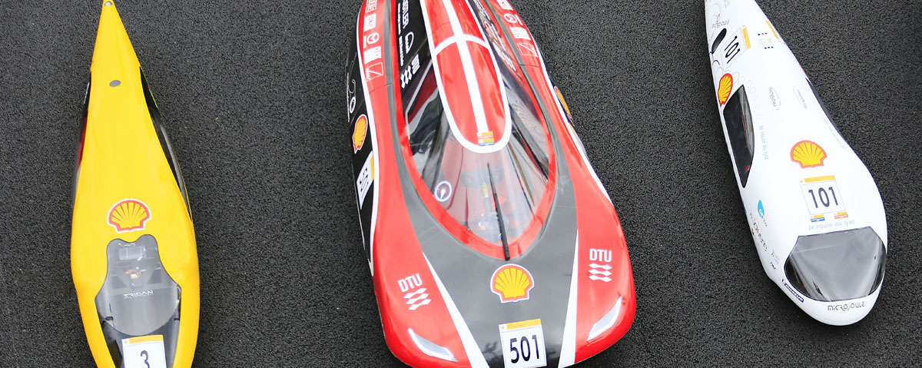
Divider slide title line Section 02
Please note: These default picture boxes have a hole cut in them to allow for the title box to be seen.
To change the picture: Delete the sample picture. Then click the insert picture icon in the middle of the picture box, when the picture appears, use the send to back command.
To crop or adjust the picture: Double click the picture to display the Format ribbon, then click the Crop tool. Then use the white points to crop or position the picture within the box. Do not use the black crop bars which will change the shape of the picture box. (As shown on slide 12.)
Subtitle/additional information if required

Slide 10
Standard text slide
Subheading can appear here if required
First level of sub-information - Increase list level 1
First level of sub-information - Increase list level 1
Additional text can appear here if required.
Second level of sub-information - Increase list level 2
Third level of sub-information - Increase list level 3
Please note: To get a bullet point do not use the ‘Bullets’ icon on the toolbar, but rather the ‘Increase List Level’ or ‘Indent’ icon, which will give you both the correct bullet and indent.

Slide 11
Standard text slide Two column layout
First level of information
First level of sub-information list level 1
Second level of sub-information Increase list level 2
Third level of sub-information list level 3
Fourth level of sub-information Increase list level 4
Fifth level of sub-information Increase list level 5
First level of information
First level of sub-information list level 1
Second level of sub-information Increase list level 2
Third level of sub-information list level 3
Fourth level of sub-information Increase list level 4
Fifth level of sub-information Increase list level 5

Slide 12
Standard text slide Two column high content layout
High content text slides can be used when making an onscreen report, where higher than normal levels of text are required. It is recommend that copies or printouts of the document are given to the audience. This will ensure that when you talk around the projected version of this document the audience can check any smaller details or text in their own version.
Highlights can be in colour.
First level of sub-information list level 1
Second level of sub-information Increase list level 2
High content text slides can be used when making an onscreen report, where higher than normal levels of text are required. It is recommend that copies or printouts of the document are given to the audience. This will ensure that when you talk around the projected version of this document the audience can check any smaller details or text in their own version.
Highlights can be in colour.
First level of sub-information list level 1
Second level of sub-information Increase list level 2

Slide 13


Full bleed image slide
First level of information
First level of sub-information
Second level of sub-information
Use white square point to adjust or crop image.
DO NOT use black bars which will change the shape of the picture box
Please note: These default picture boxes have a hole cut in them to allow the yellow bar on the slide master to be seen.
To change the picture: Delete the sample picture. Then click the insert picture icon in the middle of the picture box, when the picture appears, use the send to back command.
To crop or adjust the picture: Double click the picture to display the Format ribbon, then click the Crop tool. Then use the white points to crop or position the picture within the box. Do not use the black crop bars which will change the shape of the picture box. (As shown on slide 12.)
Use white square point to adjust or crop image.
Copyright of Shell International B.V.

Slide 14
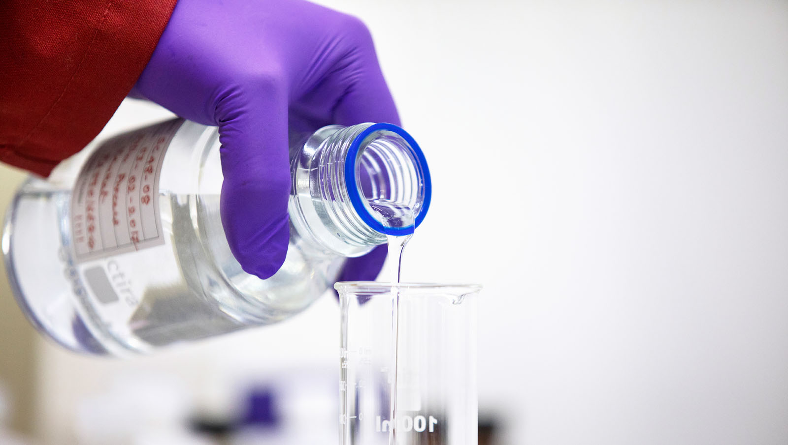
“A tagline could be used here on top of the image”
The statement text can be moved freely around the slide, allowing for optimal placement over background images.
To change the picture: Delete the sample picture. Then click the insert picture icon in the middle of the picture box, when the picture appears, use the send to back command.
Copyright of Shell International B.V.

Slide 15
Sample chart showing correct colours and sequence

Slide 16
Questions and Answers

